Slide 1

Restaurant location recommendation
Sudhir Bangaru.
07/06/2020

Slide 2
Problem statement
A year ago, a friend of mine had moved to Blacksburg, Virginia, USA. She has observed that there are many Indians and Asians settled around Virginia Tech University. However, there are not many Indian restaurants around. Herself being a good cook, she senses there is a good business opportunity to open a restaurant with Indian cuisine. She had recently requested me to study the feasibility of the idea and suggest a location. I have considered taking this as my problem statement for the capstone project.

Slide 3

Part I: Analysis of US census data

Slide 4
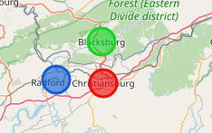
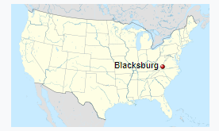
Blacksburg Metropolitan Statistical Area
From wikipedia

Slide 5
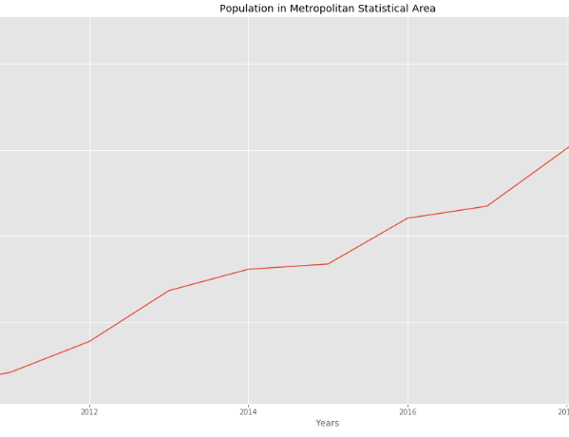
MSA population in the last 10 years
The graph shows the population in Blacksburg in last 10 years. From 2017 we see a spurt in population growth rate.

Slide 6
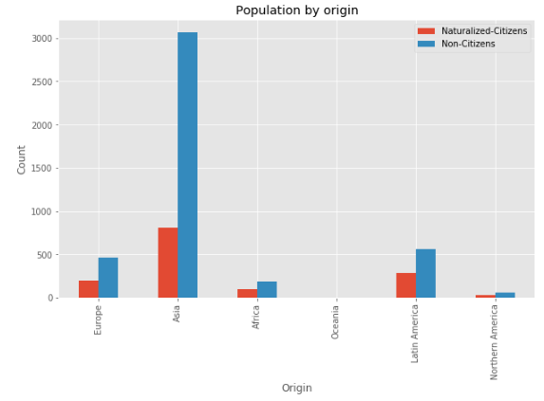
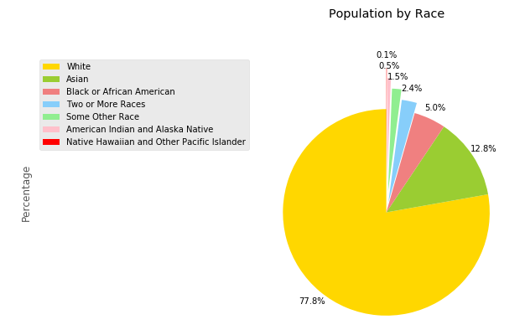
Blacksburg population by race
From the graph we can observe that Asians form the biggest group of immigrants to Blacksburg.

Slide 7
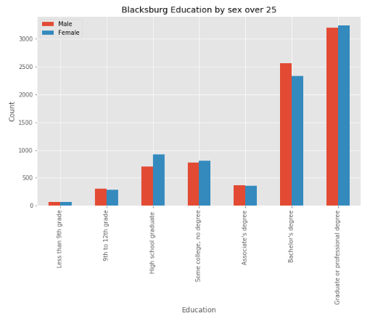
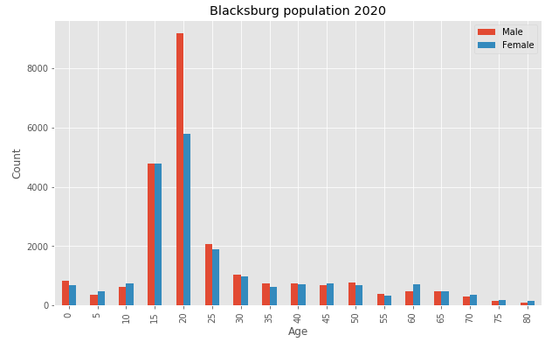
Blacksburg age and education
From the graphs we can infer that most of the population consists of students in the age group of 15 to 30 studying for Bachelors or Graduate degree.

Slide 8
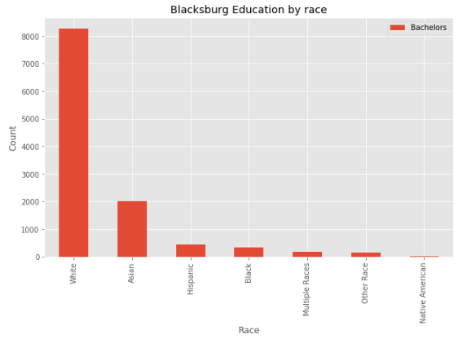
Education by race
Asians are the largest group of immigrant races among other immigrants or citizens.

Slide 9
Summary
Most of the Blacksburg population consists of students in the age group of 15 to 25.
Asians form largest group of immigrants.

Slide 10
Part II: Search for Indian restaurants

Slide 11
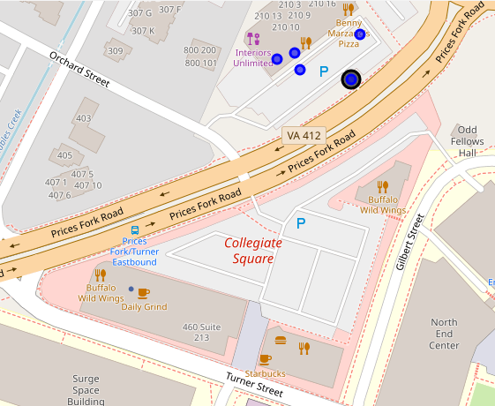
Restaurants in Blacksburg
Indian restaurant is marked in black on the map

Slide 12
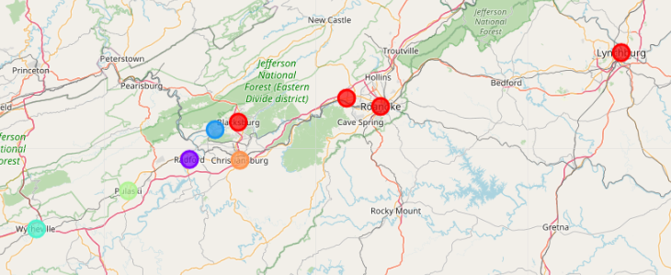
Search for other Indian restaurants in nearby neighborhoods
Neighborhoods are marked by circles

Slide 13
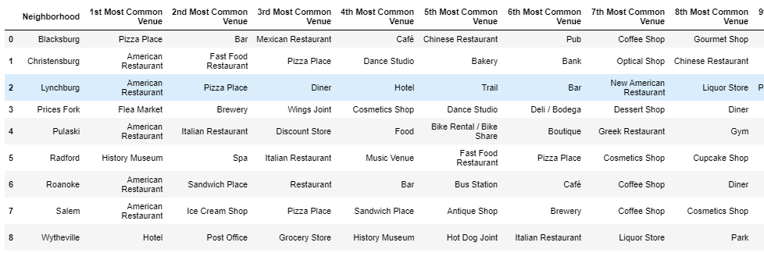
Top 10 common venues in nearby neighborhoods.

Slide 14
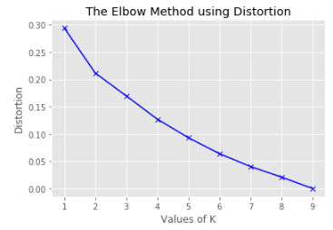
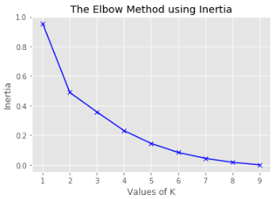
Clustering Methodology: k-means
The elbow method was used to select optimum cluster value. The clustering was tested using Distortion and Inertia Method. k = 6 was selected based on inertia method

Slide 15
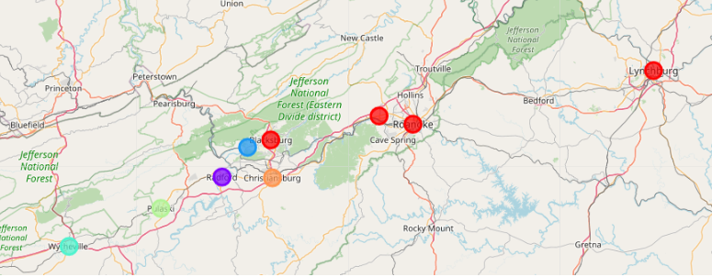
Cluster data: each color represents a cluster

Slide 16
Indian restaurants around Blacksburg and there distances from Blacksburg
Restaurant name | Location | Rating | Distance from Blacksburg in miles
India Garden | Prices Fork Road | 7 | 2.5
Nawab Indian cuisine | Roanoke | 8.5 | 42
Swagat Indian cuisine | Roanoke | Not available | 42
Hot & Cold Cafe | Lynchburg | 6.7 | 94.7

Slide 17
Conclusion
Blacksburg is home to many international graduate students, especially Asians. Based on year on year data it is safe to conclude that the number of Asians in Blacksburg MSA is increasing steadily.
Based on the clustering and data analysis of Indian restaurants, two locations can be recommended

Slide 18
Recommendation I
Restaurant name | Location | Rating | Distance from Blacksburg in miles
India Garden | Prices Fork Road | 7 | 2.5
Nawab Indian cuisine | Roanoke | 8.5 | 42
Swagat Indian cuisine | Roanoke | Not available | 42
Hot & Cold Cafe | Lynchburg | 6.7 | 94.7
From the table, we can see that there is no restaurant in Blacksburg, while the closest is 2.5 miles away. On a regular day, students or staff would generally prefer to dine in at the nearest restaurant to save time. Thus, Blacksburg can be one of the locations.

Slide 19
Recommendation II
The second location is based on k-means clustering is Christiansburg. Christiansburg is a business area with a bank, a few restaurants, and supermarkets. Also, it is interesting to note that there are no supermarkets in Blacksburg other than the Farmers market. Also, Christiansburg is located in between Radford, home to Radford University and Blacksburg, home to Virginia Tech University. Thus, it forms an ideal location accessible by both the university students.

Slide 20

Thank you

